Slide 1
Agenda
Start | End | Item
 |  | Logistic Regression Catch-up
 |  | East Side Vs West Side!
 |  | Absenteeism KNN example
 |  | Break
 |  | Supplemental?

Slide 2

NCAA Classification Madness
College Basketball
Annual 64 team tournament
Business Impact:
$1B wagered
$2B in lost productivity
Bragging Rights
Objective: Identify the probability of a team winning in Round 1.

Slide 3

My friend Mandy is next level.
https://fivethirtyeight.com/features/how-a-data-scientist-whod-never-heard-of-basketball-mastered-march-madness/

Slide 4
Logistic Regression
Extends idea of linear regression to situation where outcome variable is categorical
Instead of ordinary least squares, β are derived through an iterative process called maximum likelihood estimation
We focus on binary classification
i.e. Y=0 or Y=1

Slide 5
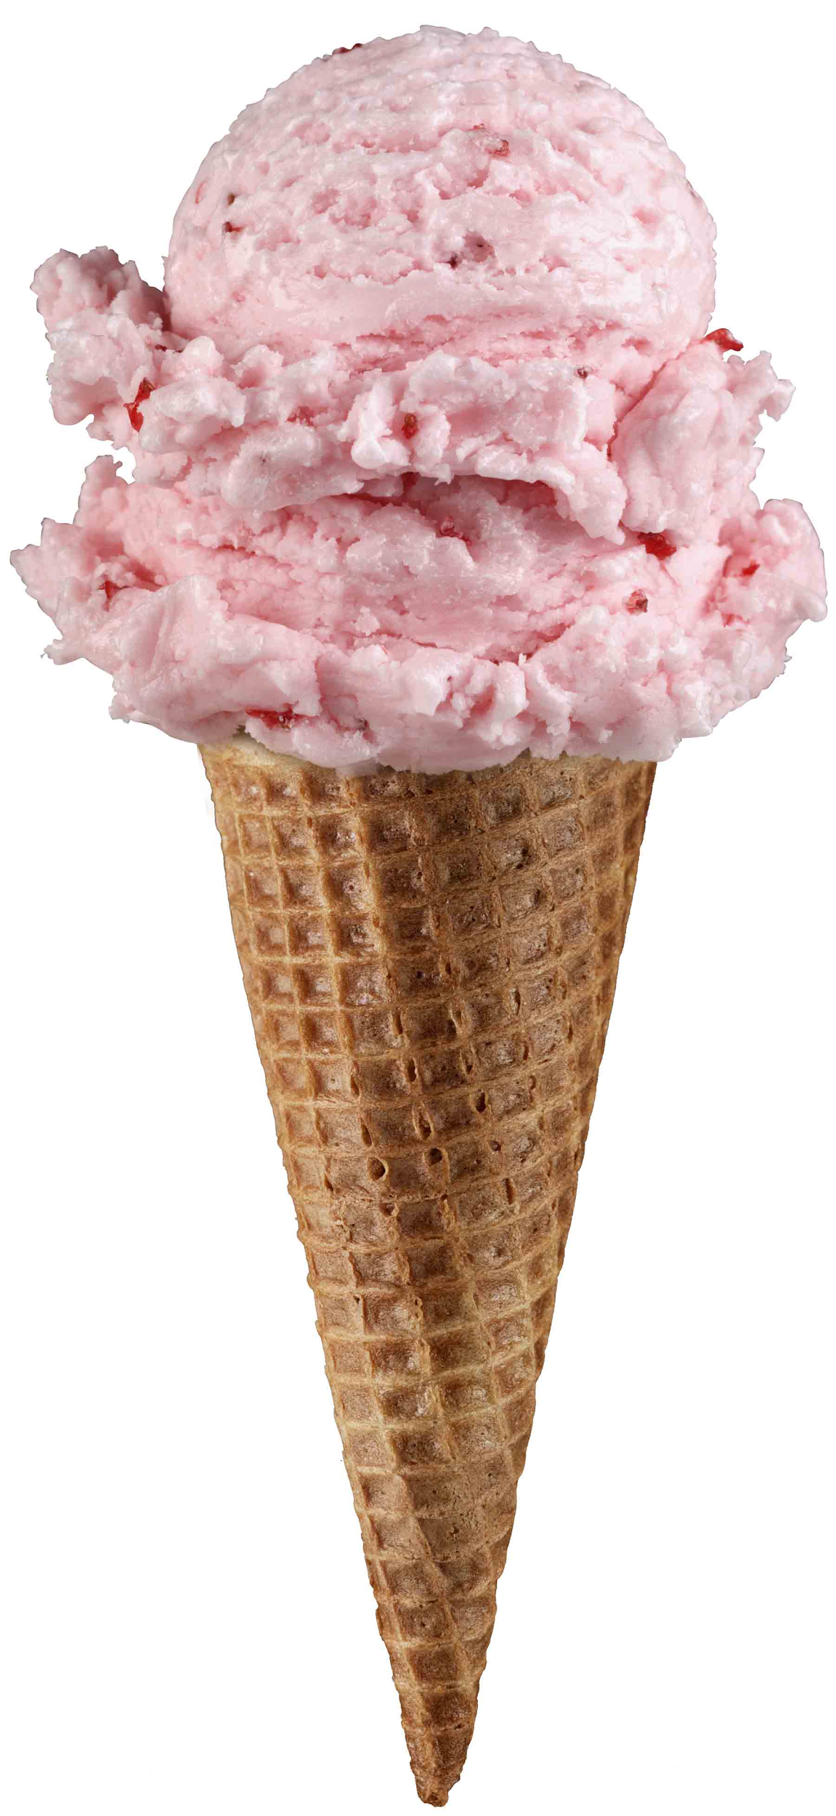
Regression Equation Review
Regression
How Many Cones?
#
= $β$ + $β$*temperature + $β$*day + $β$*price + error

Slide 6
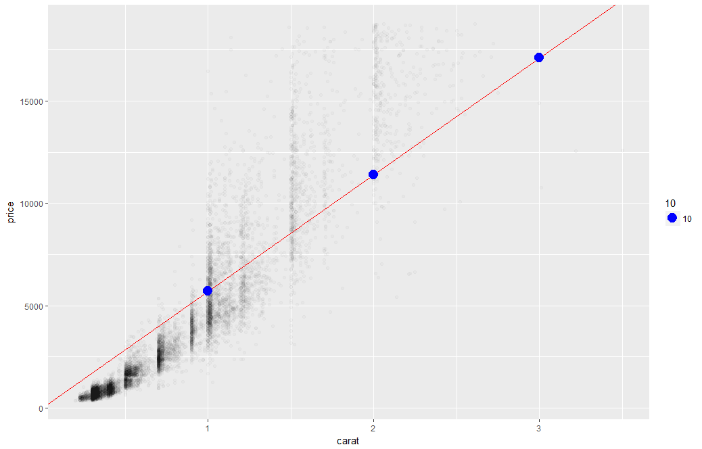
Linear Regression
The predictions is continuous…it continues forever.

Slide 7
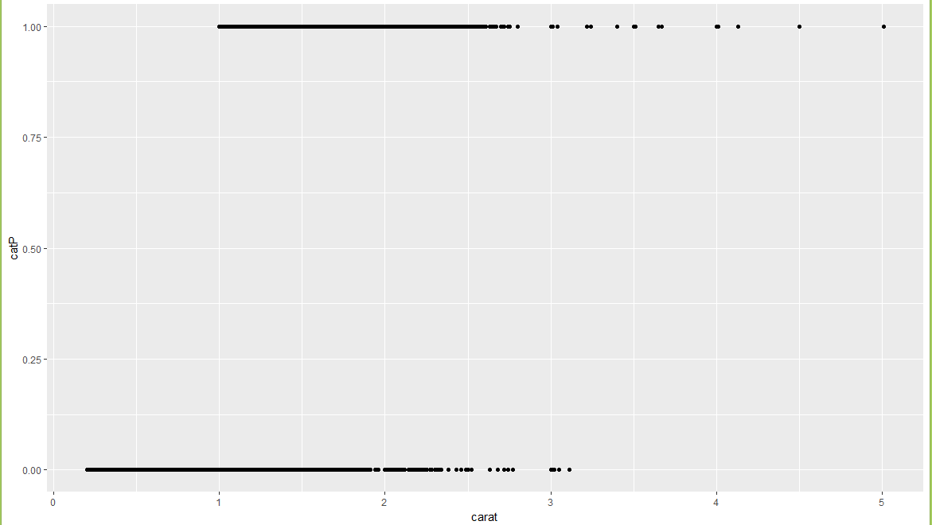
A binary relationship between carat and price
Diamonds above or below $11K

Slide 8
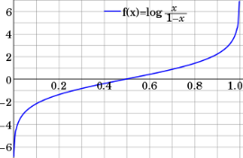
Step 1: Logistic Response Function
Regression
How Many Cones?
#
= $β$ + $β$*temperature + $β$*day + $β$*price + error
Logistic Regression
Will they buy a cone Y/N?
Logit of
= $β$ + $β$*temperature + $β$*day + $β$*price + error
We will let R handle calculating the equation output logOdds to the more understandable probability.

Slide 9
A binary relationship between carat and price
Diamonds above or below $11K
If the data only has two values, 0/1 but the regression equation goes to infinity.
This makes no sense!
“is this diamond worth more than $11K or not.” Predicting 2 means 2 yes’es?

Slide 10
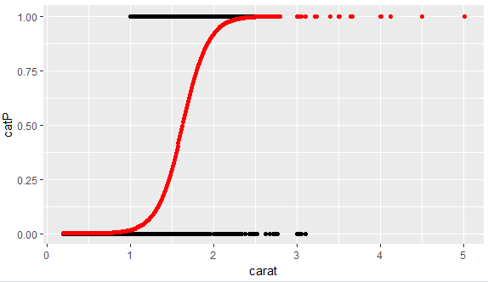
1.
What is the log-odds of the price above $11K? = Beta + Beta*Carat
2. Convert to probability with logistic response function (e^l / (1+e^l)
3. The probabilities are more intuitive than the log-odds from the equation.

Slide 11
From probability to class, define a cutoff threshold.
0.50 is popular initial choice
Additional considerations (see Chapter 5)
Maximize classification accuracy
Maximize sensitivity (subject to min. level of specificity)
Minimize false positives (subject to max. false negative rate)
Minimize expected cost of misclassification (need to specify costs)
If a team has a probability of .25 classify them as a loser.
If a team has .50 or more classify them as a winner

Slide 12
Let’s practice
Open G_fullyMarchMadnessREVISED.R
In the previous week’s folder we had version F but will skip it to ensure we cover the rest of the topics. Its worth a review for more code examples and to see the logistic response function manually calculated.

Slide 13
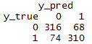
Evaluating a Classification
Confusion Matrix
The model predicted losers 390 (316 + 74) times
The model was correct 316 times for losers
The model predicted 378 winners (68+310)
The model was correct 310 times for winners
As you progress in your data science education, learning other KPI (Recall, Precision, AUC etc) in Chapter 5 is worthwhile. In this course we stick with the basic accuracy.

Slide 14
Logistic Regression Summary
Logistic regression is similar to linear regression, except that it is used with a categorical response
The predictors are related to the response Y via a nonlinear function called the logit
As in linear regression, reducing predictors can be done via variable selection
Logistic regression can be generalized to more than two classes
libray(nnet)
multiNomialLogit <- multinom(y ~ ., df)

Slide 15


Your Data Mining Toolbox
Previous Lessons
Some R Programming (R-studio)
EDA (summaries, column and row exploration)
Knowledge of Data Preparation (vtreat)
Basic Visualization (plot, ggplot)
Regression (continuous predictions)
After today
Binary Classification (logistic regression)
More complex algorithms
Regression & Logistic Regression are two good starting algorithms . Both put you on a path to more complex machine learning but more importantly you can start to frame business problems in terms algorithms can understand.

Slide 16
KNN

Slide 17
Agenda
Start | End | Item
 |  | Logistic Regression Catch-up
 |  | Break
 |  | East Side Vs West Side!
 |  | Absenteeism KNN example
 |  | Break
 |  | Supplemental?

Slide 18
Now a new Classification Approach - KNN
Characteristics of KNN
Data-driven, not heuristics (rules) based
No parameters, beta coefficients, means time to predict or classify can be lengthy because each new record is scored against the existing training set.
Makes no assumptions about the data e.g. outliers, non-normal distributions – all are accepted

Slide 19
Basic Idea
For a given record to be classified, identify nearby records
“Near” means records with similar predictor values X₁, X₂, … X_{p}
Classify the record as whatever the predominant class is among the nearby records (the “neighbors”)
Your brain makes similar associative leaps…the upcoming example proves it!

Slide 20
How to measure “nearby”?
The most popular distance measure is Euclidean distance
DON’T WORRY ABOUT THIS
R will handle it!
Typically, predictor variables are first normalized (= standardized) to put them on comparable scales
An easy and consistent method for normalization is to use preProcess() from caret but can also be done with scale()
Without normalization, metrics with large scales dominate

Slide 21

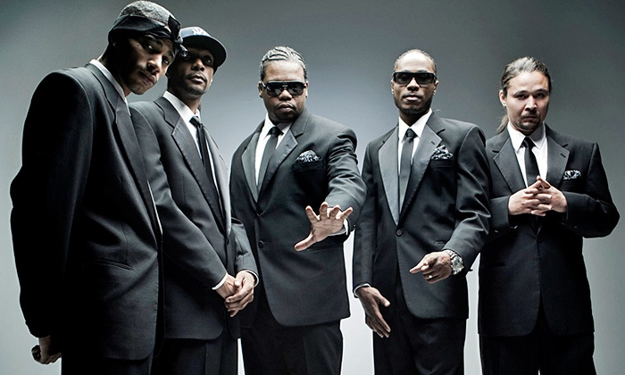
KNN Classification
Rep your HOOD!
From East 99th Street & St. Clair in Cleveland
Talk about it a lot…
Lets try to understand if a house is in East or West Cleveland and Bone Thugs would live there based on some attributes.

Slide 22
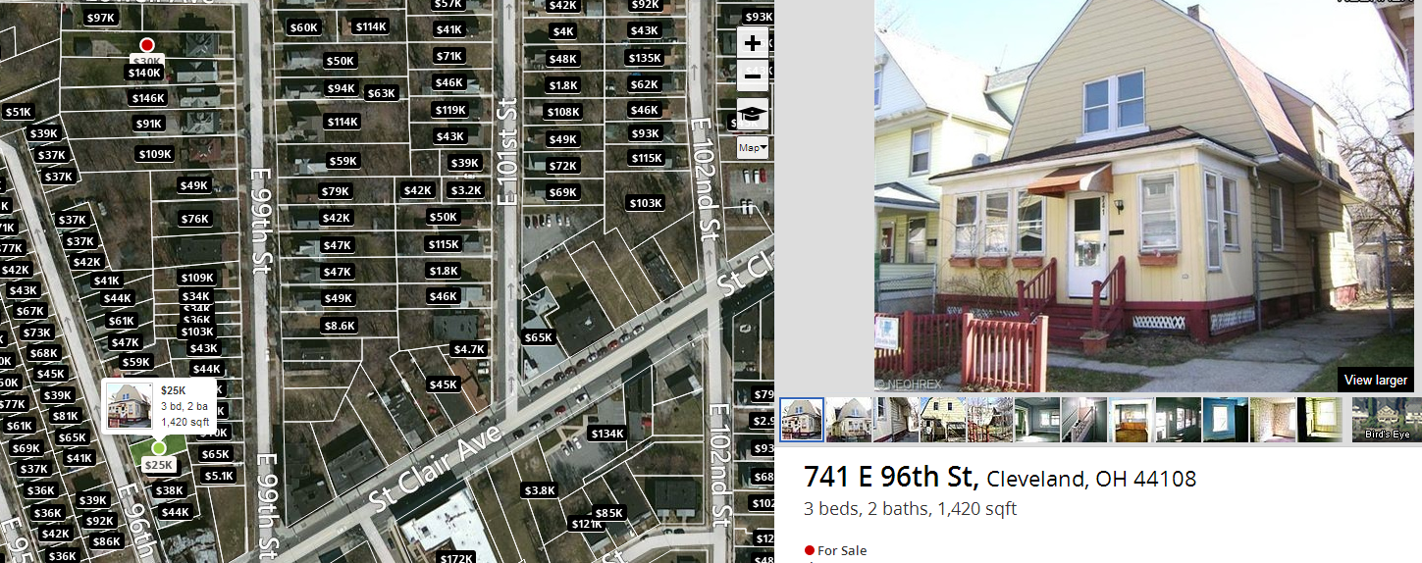
Bone Thugs Hood on Zillow

Slide 23
Attributes of houses here…
$25K
3 beds
2 baths
1,420 sqft
44108 zip

Slide 24
Collected a small data set comparing East Cleveland to West.
West Cleveland
East Cleveland
Beds | Bath | SqFt | Price
4 | 4.5 | 4110 | 1.175M
5 | 1.75 | 1616 | $155K
4 | 2 | 1480 | $64K
4 | 4 | 2640 | $279K
5 | 5 | 4175 | $525K
5 | 2.5 | 1702 | $120K
3 | 1 | 1582 | $103K
3 | 2 | 1292 | $100K
3 | 3 | 1780 | $159K
Beds | Bath | SqFt | Price
3 | 1 | 1181 | $65K
3 | 1.5 | 1391 | $39K
4 | 1 | 1424 | $39K
4 | 2 | 1895 | $30K
5 | 1 | 1607 | $50K
4 | 1 | 1312 | $11K
3 | 1 | 1152 | $5K
4 | 1 | 1556 | $81K
2 | 1 | 811 | $46K
What patterns do we observe in this data?

Slide 25
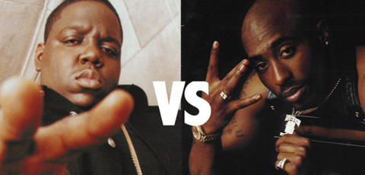
Here are some unknown houses…
East Side or West Side?
Beds | Bath | SqFt | Price
5 | 1.5 | 1136 | $48K
6 | 3 | 4500 | $259K
3 | 1.5 | 1300 | $85K
3 | 2 | 1300 | $106K
2 | 2 | 1170 | $200K
5 | 2 | 2592 | $95K
3 | 1 | 1398 | $100K
3 | 2 | 1300 | $106K
3 | 1.5 | 1614 | $124K

Slide 26
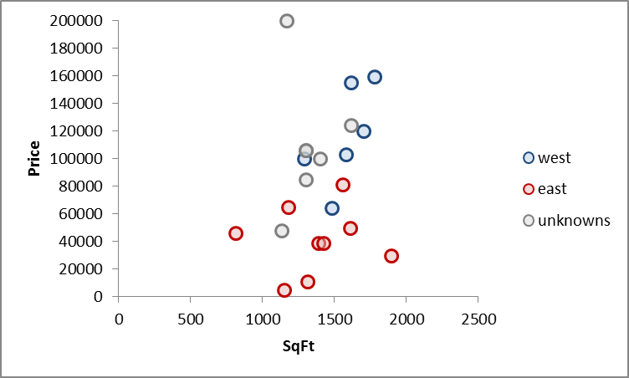
Let’s pick two house attributes, sqft and price
Plot East, West and Unknown houses on a scatter

Slide 27
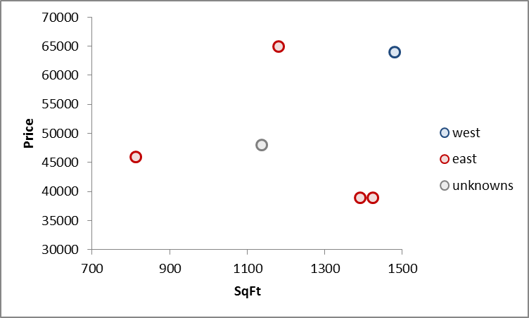
KNN Measures the Euclidean distance between points
Lets zoom in to a specific point
Without knowing distances or making calculations:
What side of the city do you think the unknown is?

Slide 28
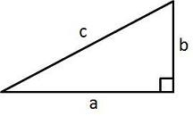
Euclidean Distance measures distance like a ruler
Remember Pythagorean Theorem?
In our example…
A²+B²=C²
b
c
a

Slide 29
Euclidean Distance measures distance like a ruler
In our example…
Define the segment values
EastSidePt = (1391sqft, $39K)
UnknownPt = (1136sqft,$48K)
aSegment = 1391-1136 = 255sqft
bSegment = $39k-$48k = $-9k
b
c
-9k
255
a

Slide 30
Euclidean Distance measures distance like a ruler
In our example…
Math time…
EastSidePt = (1391sqft, $39K)
UnknownPt = (1136sqft,$48K)
aSegment = 1391-1136 = 255sqft
bSegment = $39k-$48k = $-9k
c
A² + B² = C²
b
a
$-9000² + 255² = c ²
$81,000,000 + 65025 = c ²
$81,065,025= c ²
Sqrt($81,065,025)= c
9003 = c
The distance between the unknown and the closest East side point is 9003*.
We didn’t normalize (put all attributes on the same scale) so you can see that large impact price has on the distance moving from 9000 to 9003 but that’s not the point…this is just to show you a distance calc.

Slide 31

Euclidean Distance measures distance like a ruler
Remember Pythagorean Theorem?
In our example…
A²+B²=C²
c
b
a
West Side (1480sqft, $64K)
Unknown (1136sqft, $48K)
Distance
or C = 16003
Differences (45sqft, $17K)
b
a

Slide 32
Your guess K=1
16003
9003
With K = 1, the single nearest neighbor, what is the class? What about k=2? K=3?

Slide 33
K = 1
This unknown case is in…
In our example…
East Cleveland
5 Beds
1.5 Bath
1136 sqft
$48K
16003
9003
The KNN algorithm would have correctly identified East Cleveland if K = 1. Remember the algorithm performs this along more than 2 dimensions, in hyperspace.

Slide 34
K is a tuning parameter the practitioner chooses.
You will have to specify how many neighbors are to be looked at.
In our example…
Measured in hyperspace (many attributes not just 2)
Ties are randomly chosen for even number K but can be avoided using odd number K.
Returned results can be either the class (east or west) or the probability of a particular class.
17000
16003
9003
*scale is misleading because of attributes order of magnitude
Remember to normalize!
K=1 of only these 2 variables would say it is East Cleveland with a 100% certainty.
K=3 of only these 2 variables would say it is East Cleveland with a 66% probability.
Review confusion table to get to an acceptable K.

Slide 35



K is a tuning parameter the practitioner chooses.
Nearest Neighbor
K = 1
17000
16003
1 Red Neighbor / k =1 = 100% red
9003
K = 3
*scale is misleading because of attributes order of magnitude
Remember to normalize!
2 Red Neighbor / k =3 = 66% red

Slide 36


Special K!
?
Perhaps more so than other methods, tuning your KNN is of the utmost importance.

Slide 37
Special K!
K=1
?
K | Big House | Lil House | Guess | Actual | Notes
1 | 1 | 0 | Big House |  | Local Structure
Perhaps more so than other methods, tuning your KNN is of the utmost importance.

Slide 38

Special K!
K=1
?
K | Big House | Lil House | Guess | Actual | Notes
1 | 1 | 0 | Big House |  | Local Structure
5 | 1 | 4 | Lil House |  | Just right
K=5
Perhaps more so than other methods, tuning your KNN is of the utmost importance.

Slide 39
Special K!
K=1
?
K | Big House | Lil House | Guess | Actual | Notes
1 | 1 | 0 | Big House |  | Local Structure
5 | 1 | 4 | Lil House |  | Just right
10 | 6 | 4 | Big House |  | Majority Structure
K=5
K=10
Perhaps more so than other methods, tuning your KNN is of the utmost importance.

Slide 40
Choosing k
K is the number of nearby neighbors to be used to classify the new record
K=1 means use the single nearest record
K=5 means use the 5 nearest records all have a “vote”
Typically choose that value of k which has lowest error rate in validation data
Use odd numbers to avoid ties
Let’s predict the probability of “Class A”
K= | Possible Outcomes
1 | Nearest neighbor is class A so 100% therefore class B probability is 0%
2 | Nearest 2 neighbors agree class A so 100%, or all neighbors are class B so 0% or neighbors are split so outcome is 50%
3 | Nearest 3 neighbors agree class A so 100%, or all neighbors are class B so 0%, or they split 33% or 66%. With a cutoff of 50% you can still make a classification.
4 | Nearest 4 neighbors agree class A so 100%, all neighbors are class B so 0%, or they split 25%, 50% or 75%. Cases of 50% probability are troublesome to determine same as K = 2.

Slide 41

Open 1_normalization example_REVISED.R
VTREAT will NOT scale your data!!
This script will show you how R “scales” and “centers” data to be on the same magnitude. We did it as part of the preprocessing lesson.

Slide 42
Agenda
Start | End | Item
 |  | Logistic Regression Catch-up
 |  | Break
 |  | East Side Vs West Side!
 |  | Absenteeism KNN example
 |  | Break
 |  | Supplemental?

Slide 43

Classifying Absenteeism at Work
Business Context:
Workers that are absent are costly to businesses.
In the US absenteeism is estimated to cost $225.8B or $1685 per employee EACH YEAR*
Understanding absenteeism reasons could lead employers to offer new benefits (like in office medical services) to reduce absenteeism
Dataset Source and Info:
http://archive.ics.uci.edu/ml/datasets/Absenteeism+at+work
The database was created with records of absenteeism at work from July 2007 to July 2010 at a courier company in Brazil.
740 Rows * 21 Attributes
Our business objective is to classify the reason the employee is missing so we can possibly tailor employee support.
“What is the probability the absent employee is out because of “dental consultation” or “medical consolation”?
https://www.cdcfoundation.org/pr/2015/worker-illness-and-injury-costs-us-employers-225-billion-annually

Slide 44

Open knn example classification.R
When someone calls in the operator lists a reason for the absence.
Reason.for.absence
lowFreq :272
reason_0 : 43
reason_13: 55
reason_19: 40
We will build a KNN model classifying the reasons employees have been absent. A model like this can help classify new absent employees so we can learn what to offer to mitigate absenteeism costs and not ask employees directly.

Slide 45
Using K-NN for Prediction (Continuous)
Instead of “majority vote determines class” use average of response values
May be a weighted average, weight decreasing with distance
KNN has drawbacks but can be used for both prediction and classification so it demonstrates flexibility in that regard.

Slide 46
KNN is helpful for both business problems.
Class & Probability
K = 1
1 Red Neighbor / k =1 = 100% red
K = 3
2 Red Neighbor / k =3 = 66% red

Slide 47
KNN is helpful for both business problems.
Classification
Prediction
K = 1
K = 1
10hrs
1 Red Neighbor / k =1 = 100% red
Average of k =1 neighbor = 10
10hrs
K = 3
K = 3
0hrs
10hrs
2 Red Neighbor / k =3 = 66% red
Average of k =3 neighbors
= (10+5+0) / 3 = 5hrs

Slide 48

Open knn example prediction.R
Historical human resource records show the amount of time called out.
Absenteeism.time.in.hours
Min: 0
1st Qu.: 2
Median: 3
Mean: 6.92
3rd Qu.: 8
Max: 120
Now let’s predict how much time an absent employee will miss based on their attributes. The predicted outcome is now Absenteeism.time.in.hours which ranges from 0 to 120hrs.

Slide 49
KNN Summary
Simple concept, useful for classification & prediction
Classification – majority class of nearest neighbors wins
Prediction – average value among nearest neighbors
Find distance between known and unknown records
“Curse of dimensionality” – need to limit # of predictors
Slow to predict new records –
non-parametric i.e. for every new record it must measure the distance to all data points in the training set, so the model object has to also keep all of the original data. In contrast a parametric model like linear regression has to only keep the beta coefficients so its much faster.

Slide 50
Your Data Mining Toolbox
Previous Lessons
Some R Programming (R-studio)
EDA (summaries, column and row exploration)
Knowledge of Data Preparation (vtreat)
Basic Visualization (plot, ggplot)
Regression (continuous predictions)
Today
Binary Classification (logistic regression)
KNN (continuous & classification – binary or multi)
The KNN algo is a real machine learning algorithm which can solve binary classification, multi-classification & continuous problems!

Slide 51

Appreciation for your hard work…
Homework Help!
z_homework_supplemental_studentVersion.R
Read Chapter 9

